Slide 1


Basic image processing
Yoni Chechik
www.AIisMath.com

Slide 2
References
http://szeliski.org/Book/
http://www.cs.cornell.edu/courses/cs5670/2019sp/lectures/lectures.html
http://www.cs.cmu.edu/~16385/

Slide 3

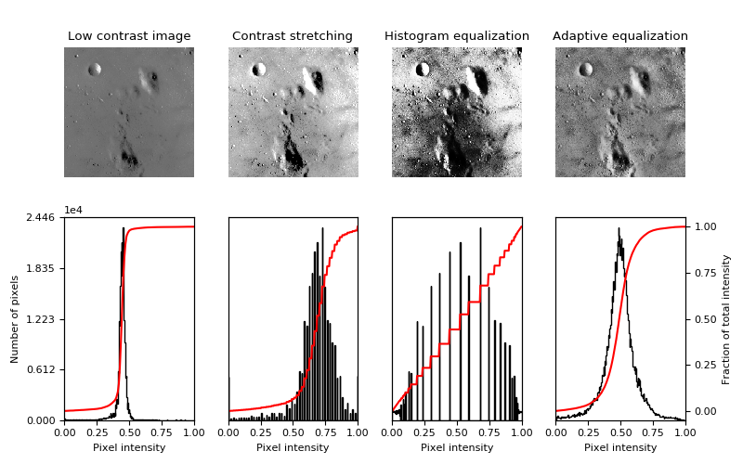
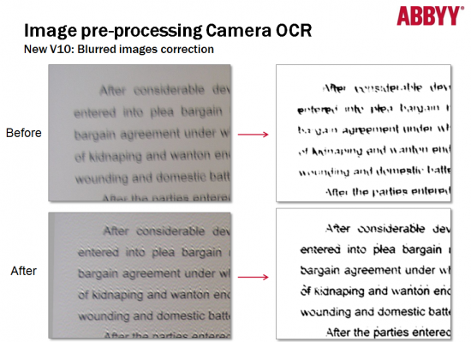
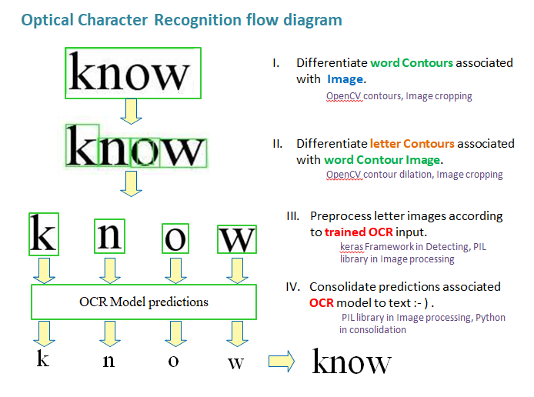
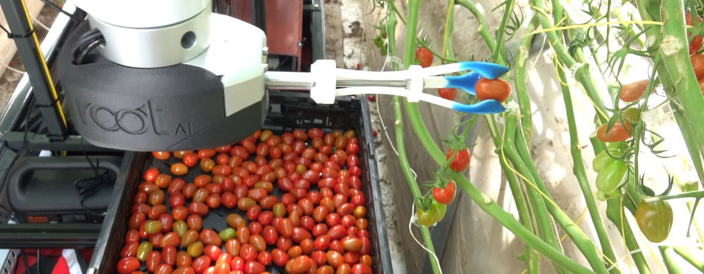
Some motivation
Art
(Photoshop color grading)
Science and space
(image enhancement)
Robotics
(OCR – optical character recognition)
Agriculture
(color ripeness detection)

Slide 4
contents
Image representation
Pixel-wise operations
Histogram equalization
Template matching
Morphology operators
Connected components
Color space

Slide 5
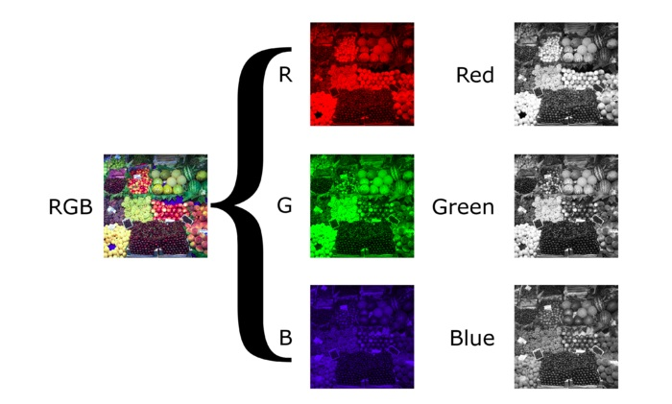
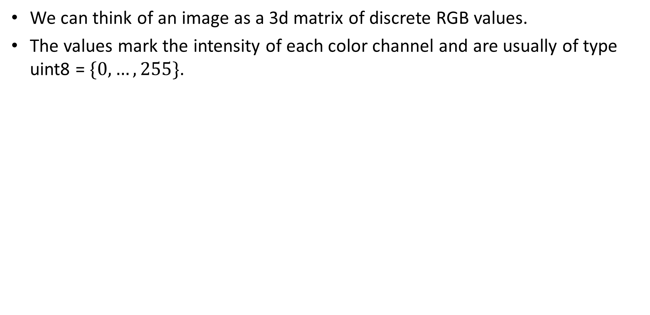
Image representation
We can think of an image as a 3d matrix of discrete RGB values.
The values mark the intensity of each color channel and are usually of type uint8 =$\{0,…,255\}$.

Slide 6
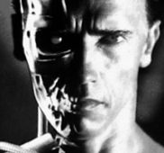
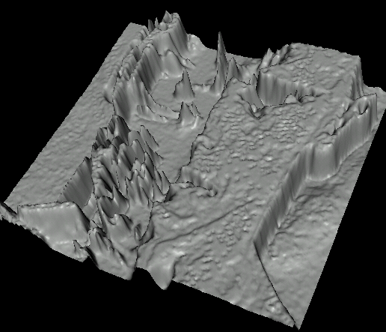
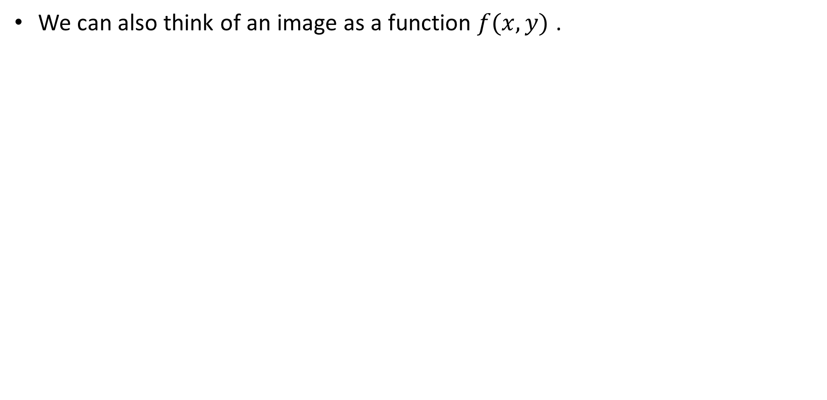
Image representation
We can also think of an image as a function $f(x,y)$ .

Slide 7
contents
Image representation
Pixel-wise operations
Histogram equalization
Template matching
Morphology operators
Connected components
Color space

Slide 8
Pixel-wise operators
Pixel-wise operators, or point operators, are defined as such that each output pixel’s value depends on only the corresponding input pixel value.

Slide 9
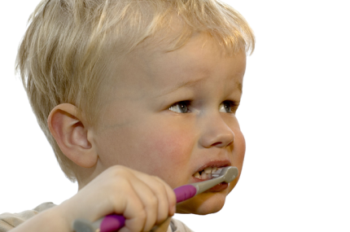
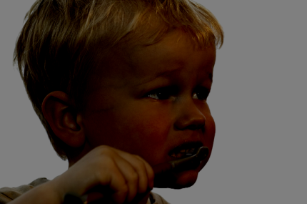
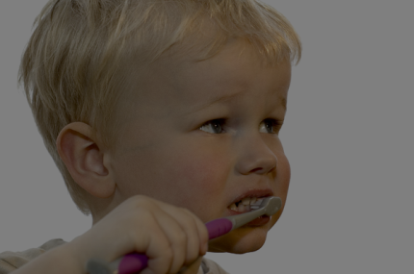
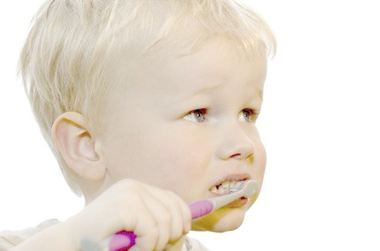
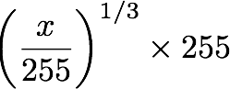
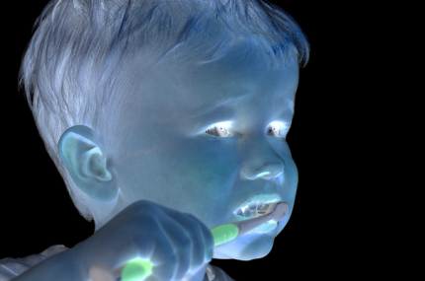
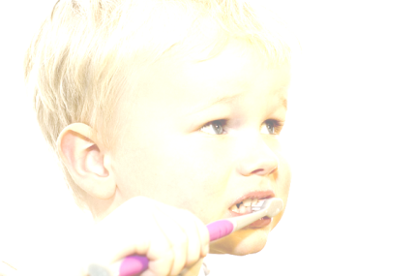

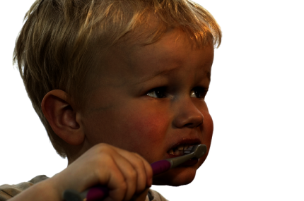
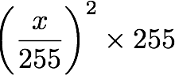
Pixel-wise operators
original
darken
lower contrast
Gamma compression
invert
lighten
raise contrast
Gamma expansion

Slide 10
Pixel-wise operators
original
darken
lower contrast
Gamma compression
invert
lighten
raise contrast
Gamma expansion

Slide 11
Pixel-wise operators
original
darken
lower contrast
Gamma compression
invert
lighten
raise contrast
Gamma expansion

Slide 12
Pixel-wise operators
original
darken
lower contrast
Gamma compression
invert
lighten
raise contrast
Gamma expansion

Slide 13
Pixel-wise operators
original
darken
lower contrast
Gamma compression
invert
lighten
raise contrast
Gamma expansion

Slide 14
Pixel-wise operators
original
darken
lower contrast
Gamma compression
invert
lighten
raise contrast
Gamma expansion

Slide 15
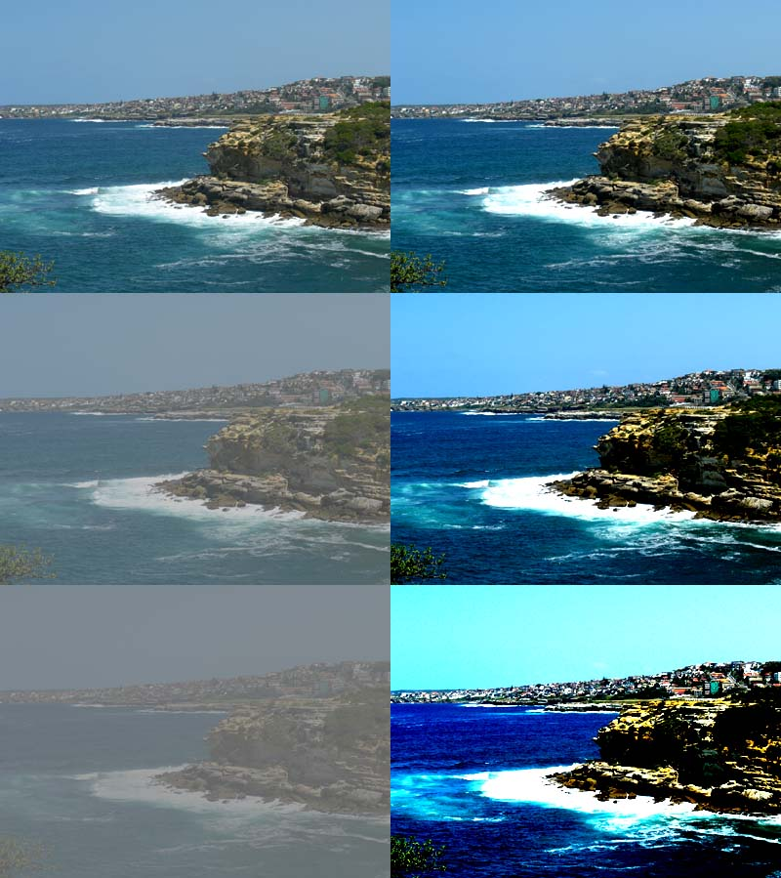
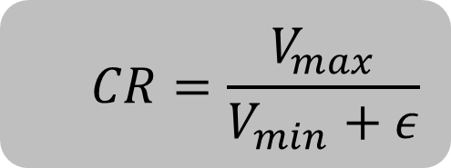
Contrast
Contrast in visual perception is the difference in appearance of two or more parts of a seen field.
The human visual system is more sensitive to contrast than absolute luminance;
Contrast ratio, or dynamic range, is the ratio between the largest and smallest values of the image or:
$$CR=\frac{V_{max}}{V_{min}+ε}$$

Slide 16
Contrast
Example of calculating contrast ratio in determining website accessibility:
https://contrast-ratio.com/#%23000000-on-white
https://www.accessibility-developer-guide.com/knowledge/colours-and-contrast/how-to-calculate/

Slide 17
Pixel-wise operators
original
darken
lower contrast
Gamma compression
invert
lighten
raise contrast
Gamma expansion

Slide 18
Pixel-wise operators
original
darken
lower contrast
Gamma compression
invert
lighten
raise contrast
Gamma expansion

Slide 19
Pixel-wise operators
original
darken
lower contrast
Gamma compression
invert
lighten
raise contrast
Gamma expansion

Slide 20
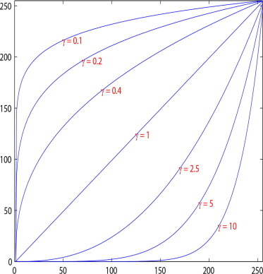
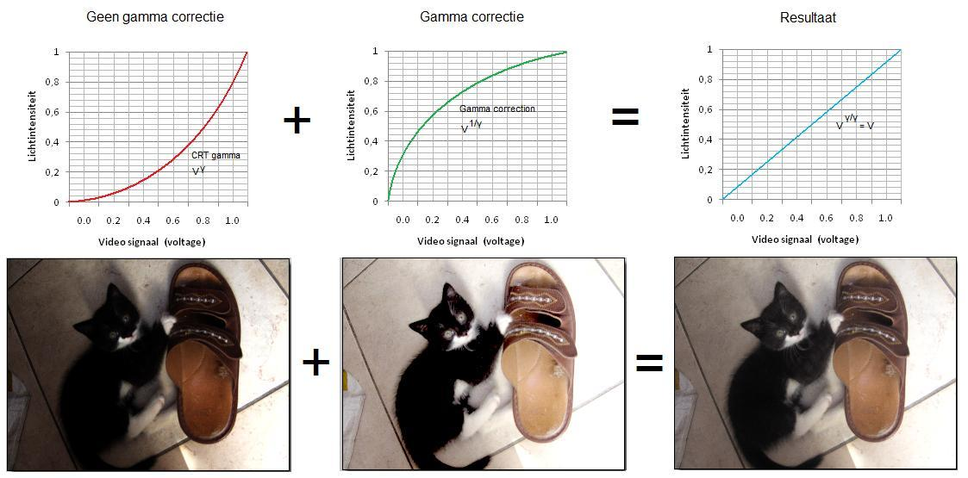
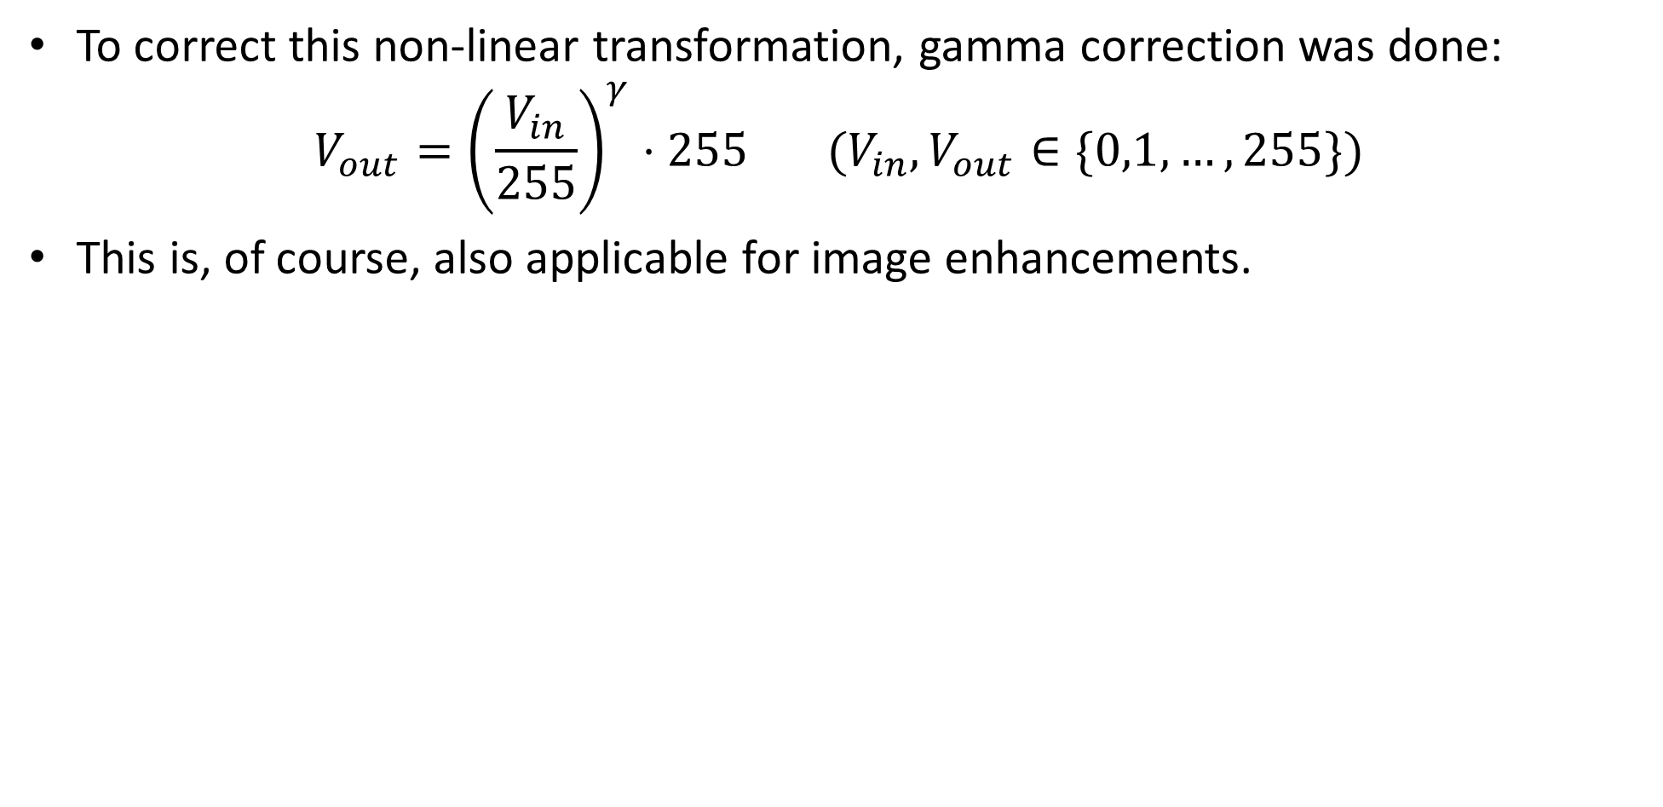
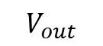
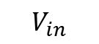
Gamma correction
To correct this non-linear transformation, gamma correction was done:
$$V_{out}={\left(\frac{V_{in}}{255}\right)}^{γ}⋅255 (V_{in},V_{out}∈\{0,1,…,255\})$$
This is, of course, also applicable for image enhancements.
$$V_{out}$$
$$V_{in}$$

Slide 21
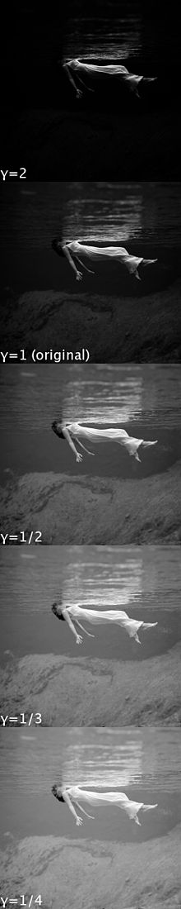
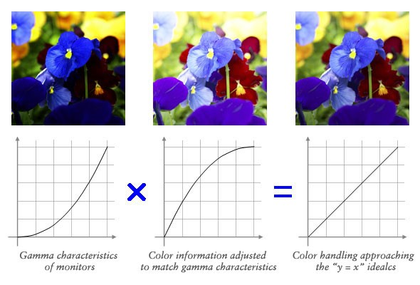
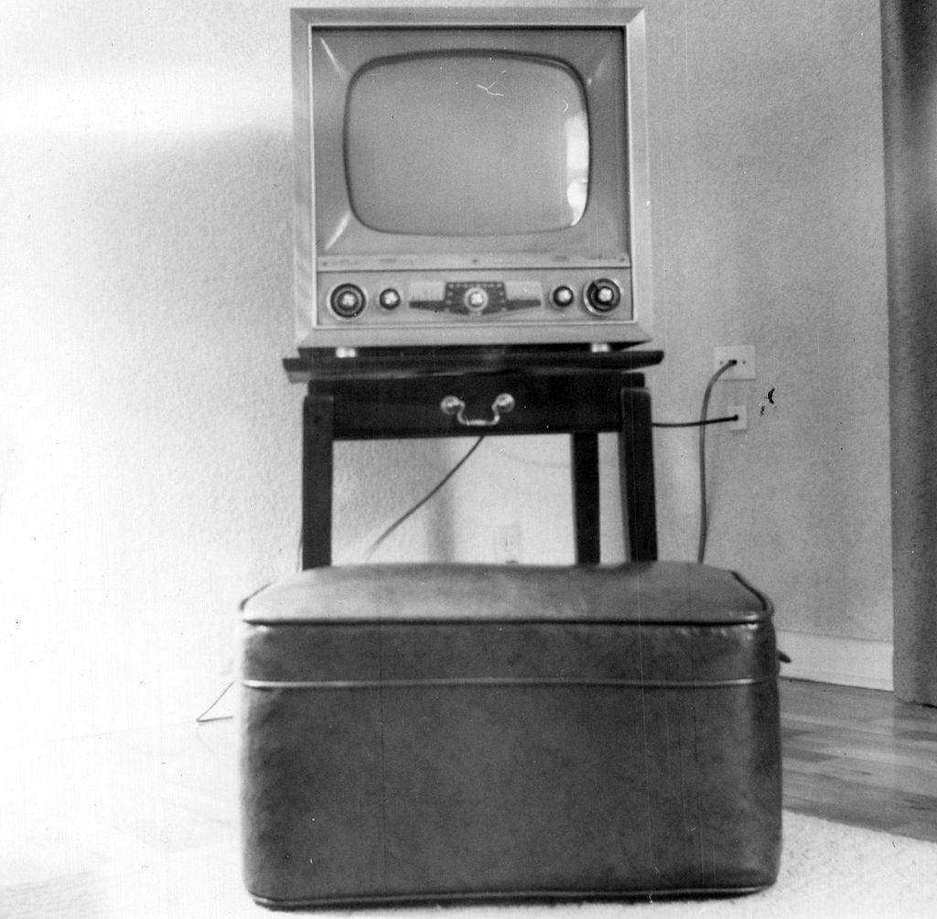
Gamma correction
Originally, Due to non-linearities in the old CRT televisions, intensities was seen different then they are.
Notes:
This is actually: function composition (הרכבת פונקציות)

Slide 22
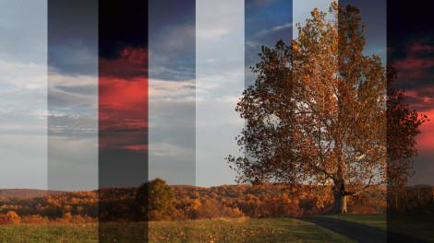
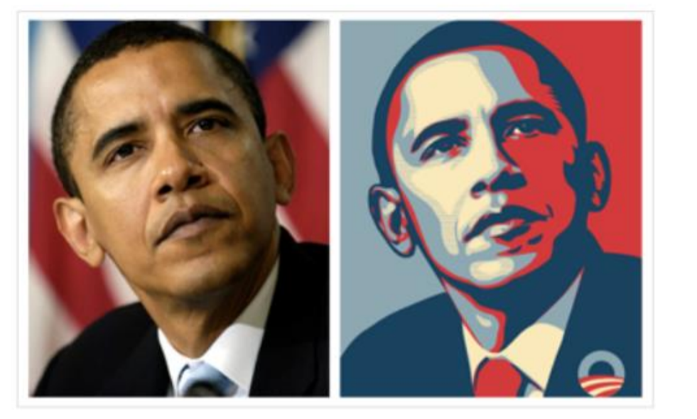
Some more point- wise operators

Slide 23
contents
Image representation
Pixel-wise operations
Histogram equalization
Template matching
Morphology operators
Connected components
Color space

Slide 24
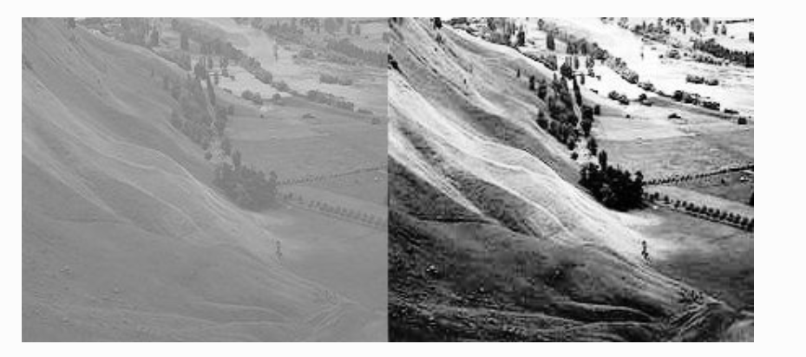
Histogram equalization
Histogram equalization is a method in image processing of contrast adjustment using the image's histogram.
This method is used to increase the global contrast of an image and is useful in images with backgrounds and foregrounds that are both bright or both dark.
Histogram equalization accomplishes this by effectively spreading out the most frequent intensity values.

Slide 26

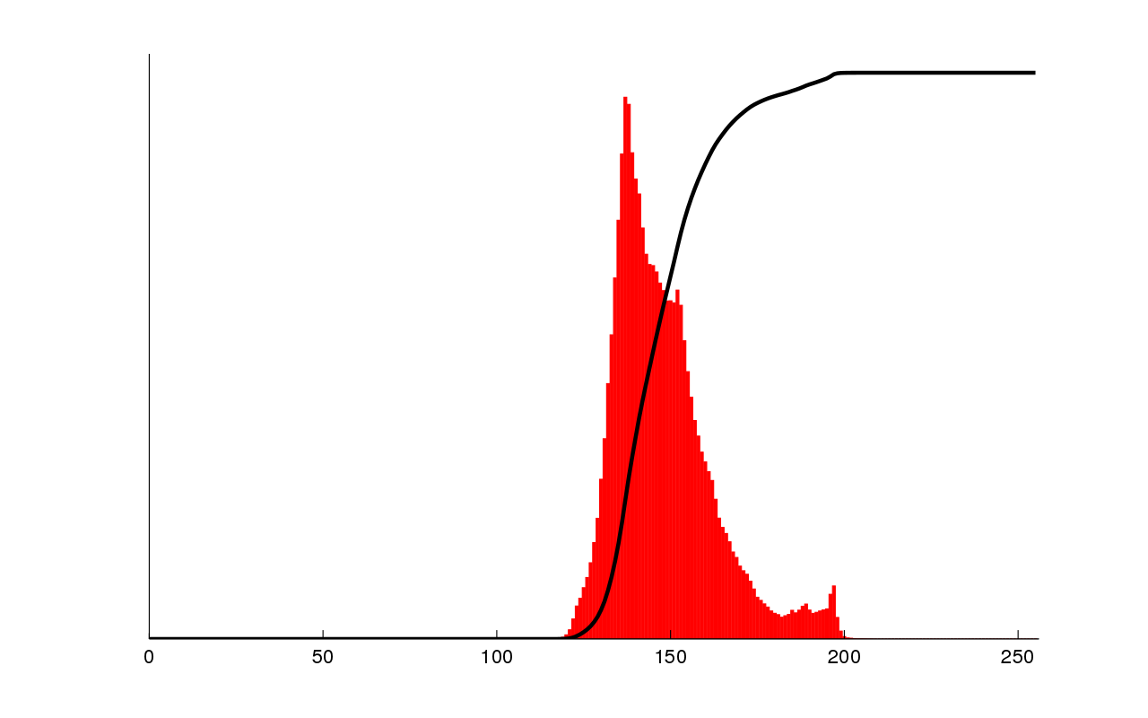
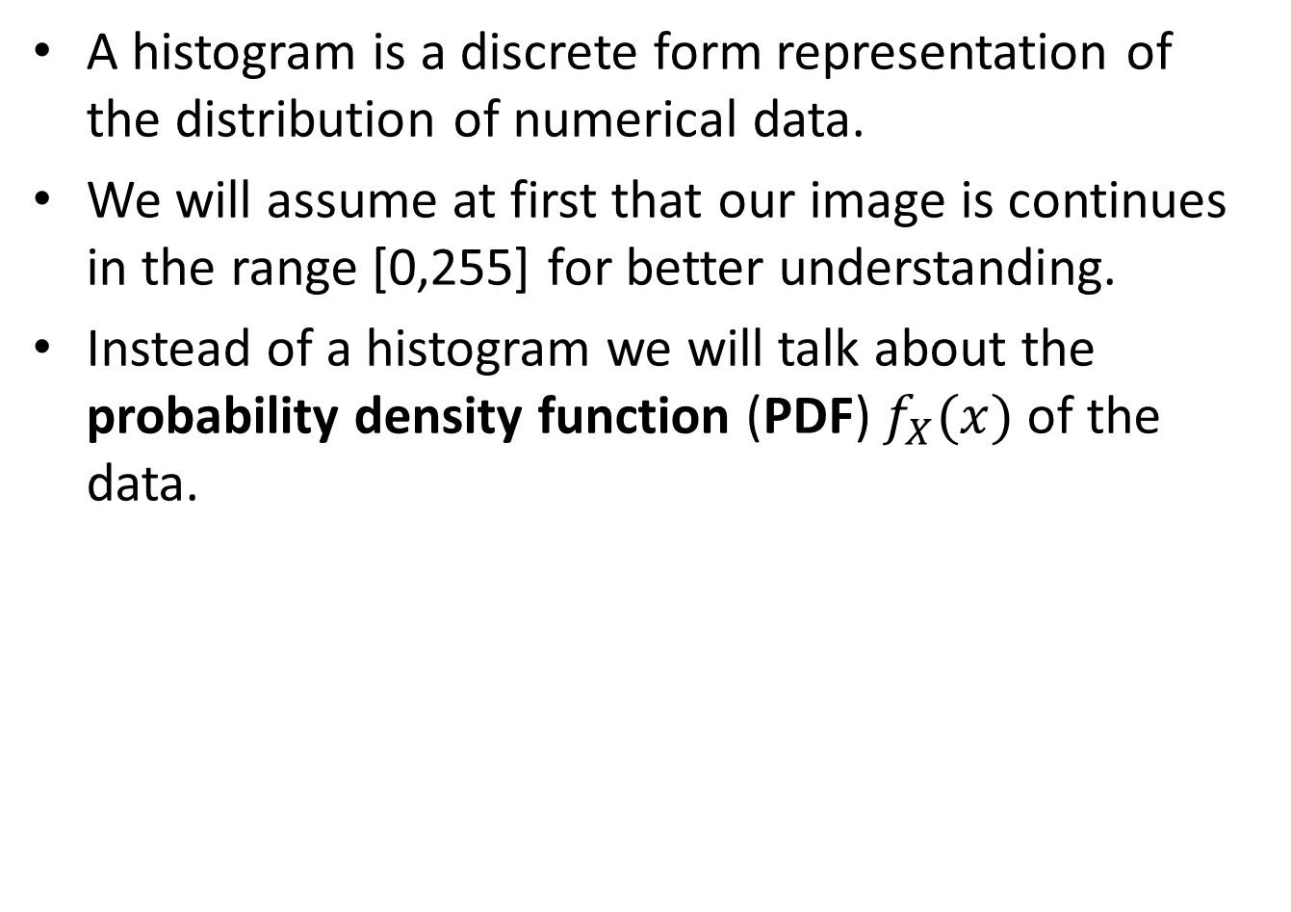
Histogram equalization
A histogram is a discrete form representation of the distribution of numerical data.
We will assume at first that our image is continues in the range [0,255] for better understanding.
Instead of a histogram we will talk about the probability density function (PDF) $f_{X}(x)$ of the data.

Slide 27
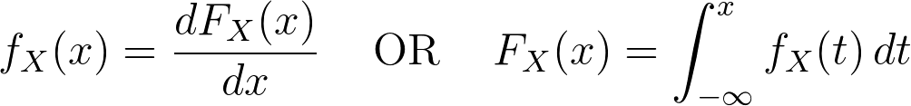
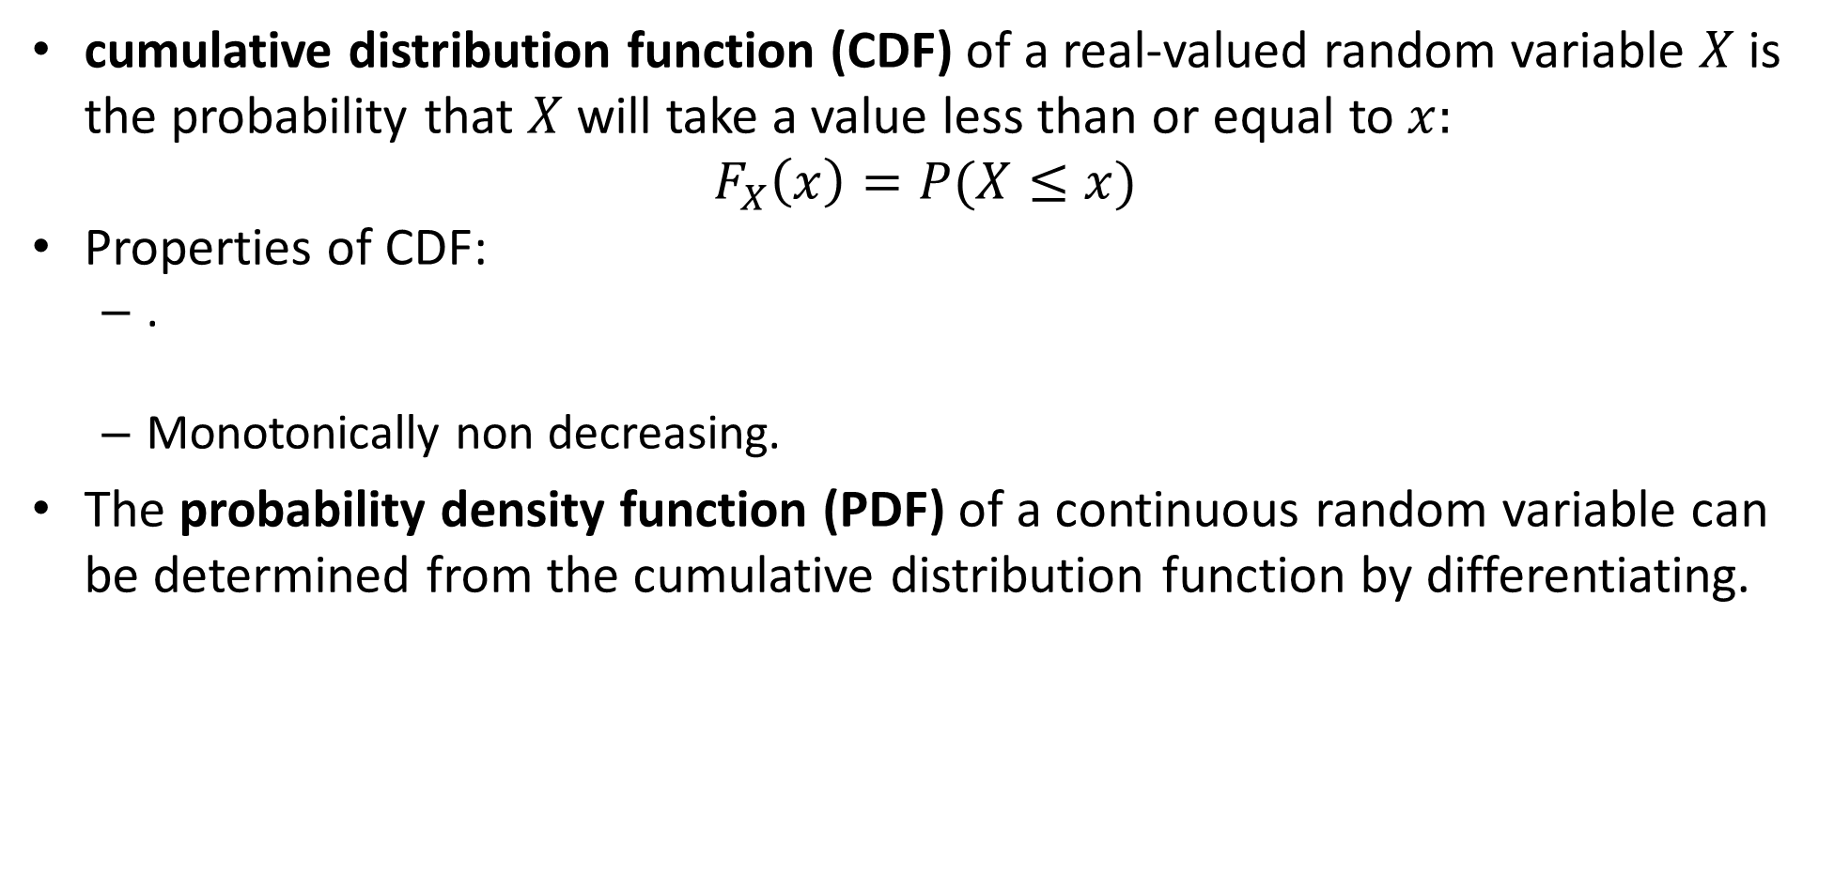
Reminder: PDF and CDF
cumulative distribution function (CDF) of a real-valued random variable $X$is the probability that $X$will take a value less than or equal to $x:$
$$F_{X}\left(x\right)=P(X≤x)$$
Properties of CDF:
.
Monotonically non decreasing.
The probability density function (PDF) of a continuous random variable can be determined from the cumulative distribution function by differentiating.
Notes:
\lim_{x\to -\infty}F_X(x)=0, \quad \lim_{x\to +\infty}F_X(x)=1
===========
f_X(x) = {dF_X(x) \over dx} \, \, \, \, \, \, \,\text{OR} \, \, \, \, \, \, \, F_X(x) = \int_{-\infty}^x f_X(t)\,dt

Slide 28
PDF definition- Wikipedia
Probability density function (PDF) can be interpreted as providing a ”relative likelihood” that the value of the random variable would equal that sample.
The absolute likelihood for a continuous random variable to take on any particular value is 0 (since there are an infinite set of possible values to begin with).
In a more precise sense, the PDF is used to specify the probability of the random variable falling within a particular range of values. This probability is given by the integral of this variable's PDF over that range and is actually the CDF.

Slide 29
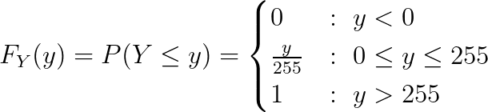
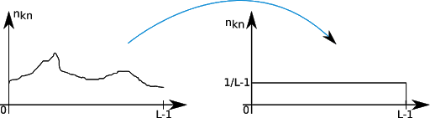
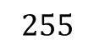
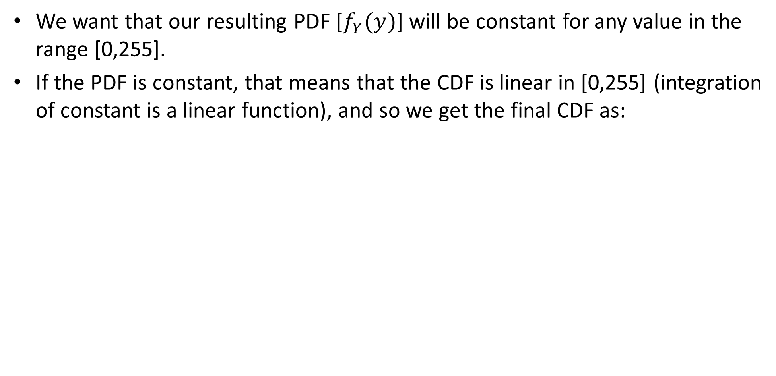
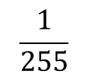
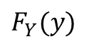
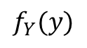

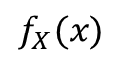
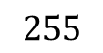
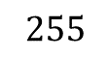
PDF equalization
We want that our resulting PDF [$f_{Y}(y)$] will be constant for any value in the range [0,255].
If the PDF is constant, that means that the CDF is linear in [0,255] (integration of constant is a linear function), and so we get the final CDF as:
$$f_{X}(x)$$
$$F_{Y}(y)$$
$$f_{Y}(y)$$
$$1$$
$$\frac{1}{255}$$
$$255$$
$$255$$
$$255$$
Notes:
F_Y(y) =P(Y \le y)= \begin{cases}
0 &:\ y < 0\\
\frac{y}{255} &:\ 0 \le y \le 255\\
1 &:\ y > 255
\end{cases}

Slide 30
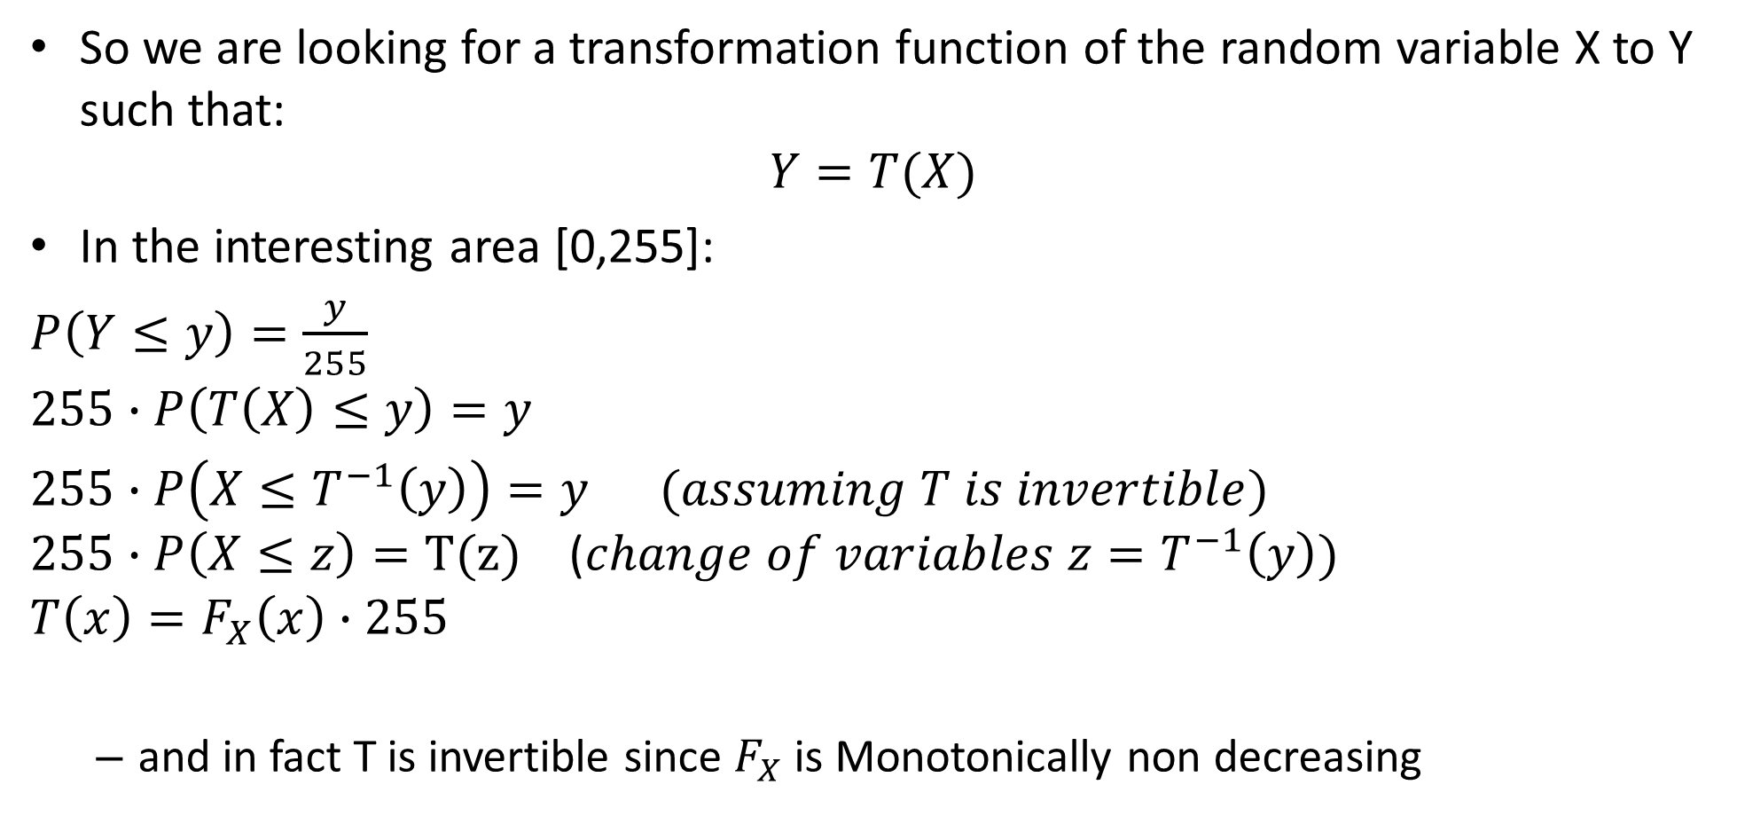
PDF equalization
So we are looking for a transformation function of the random variable X to Y such that:
$$Y=T(X)$$
In the interesting area [0,255]:
$P\left(Y≤y\right)=\frac{y}{255}$
$$255∙P\left(T\left(X\right)≤y\right)=y$$
$255∙P\left(X≤T^{−1}\left(y\right)\right)=y$ $(assuming T is invertible)$ $255∙P\left(X≤z\right)=T(z)$ ($change of variables z=T^{−1}\left(y\right))$
$$T\left(x\right)=F_{X}\left(x\right)∙255$$
and in fact T is invertible since $F_{X}$ is Monotonically non decreasing

Slide 31
PDF equalization
So we are looking for a transformation function of the random variable X to Y such that:
$$Y=T(X)$$
In the interesting area [0,255]:
$P\left(Y≤y\right)=\frac{y}{255}$
$$255∙P\left(T\left(X\right)≤y\right)=y$$
$255∙P\left(X≤T^{−1}\left(y\right)\right)=y$ $(assuming T is invertible)$ $255∙P\left(X≤z\right)=T(z)$ ($change of variables z=T^{−1}\left(y\right))$
$$T\left(x\right)=F_{X}\left(x\right)∙255$$
and in fact T is invertible since $F_{X}$ is Monotonically non decreasing

Slide 32
PDF equalization
So we are looking for a transformation function of the random variable X to Y such that:
$$Y=T(X)$$
In the interesting area [0,255]:
$P\left(Y≤y\right)=\frac{y}{255}$
$$255∙P\left(T\left(X\right)≤y\right)=y$$
$255∙P\left(X≤T^{−1}\left(y\right)\right)=y$ $(assuming T is invertible)$ $255∙P\left(X≤z\right)=T(z)$ ($change of variables z=T^{−1}\left(y\right))$
$$T\left(x\right)=F_{X}\left(x\right)∙255$$
and in fact T is invertible since $F_{X}$ is Monotonically non decreasing

Slide 33
PDF equalization
So we are looking for a transformation function of the random variable X to Y such that:
$$Y=T(X)$$
In the interesting area [0,255]:
$P\left(Y≤y\right)=\frac{y}{255}$
$$255∙P\left(T\left(X\right)≤y\right)=y$$
$255∙P\left(X≤T^{−1}\left(y\right)\right)=y$ $(assuming T is invertible)$ $255∙P\left(X≤z\right)=T(z)$ ($change of variables z=T^{−1}\left(y\right))$
$$T\left(x\right)=F_{X}\left(x\right)∙255$$
and in fact T is invertible since $F_{X}$ is Monotonically non decreasing

Slide 34
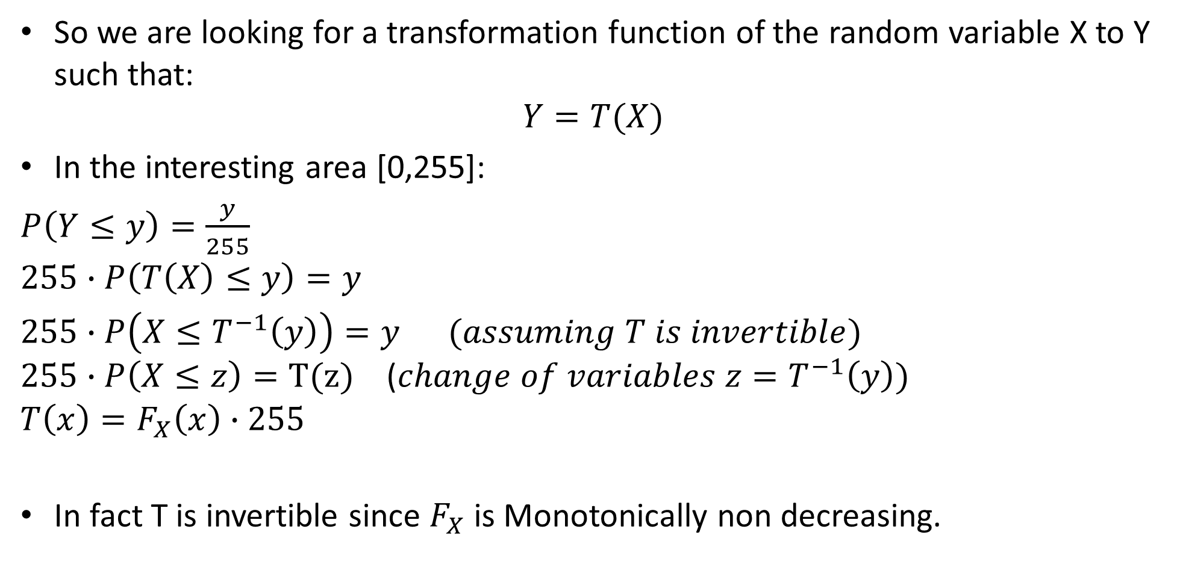
PDF equalization
So we are looking for a transformation function of the random variable X to Y such that:
$$Y=T(X)$$
In the interesting area [0,255]:
$P\left(Y≤y\right)=\frac{y}{255}$
$$255∙P\left(T\left(X\right)≤y\right)=y$$
$255∙P\left(X≤T^{−1}\left(y\right)\right)=y$ $(assuming T is invertible)$ $255∙P\left(X≤z\right)=T(z)$ ($change of variables z=T^{−1}\left(y\right))$
$$T\left(x\right)=F_{X}\left(x\right)∙255$$
In fact T is invertible since $F_{X}$ is Monotonically non decreasing.

Slide 35
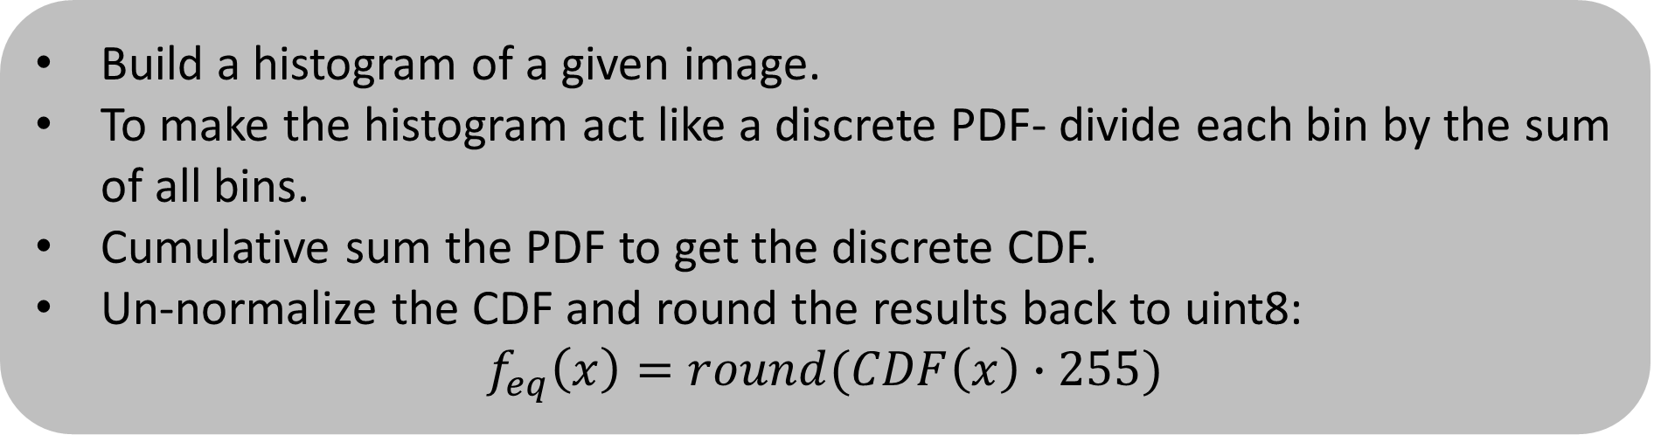
Back to histogram equalization
The same result is also applicable for discrete space like actual images and their histograms.
Build a histogram of a given image.
To make the histogram act like a discrete PDF- divide each bin by the sum of all bins.
Cumulative sum the PDF to get the discrete CDF.
Un-normalize the CDF and round the results back to uint8:
$$f_{eq}\left(x\right)=round(CDF\left(x\right)∙255)$$

Slide 36
Other variants of histogram equalization

Slide 37
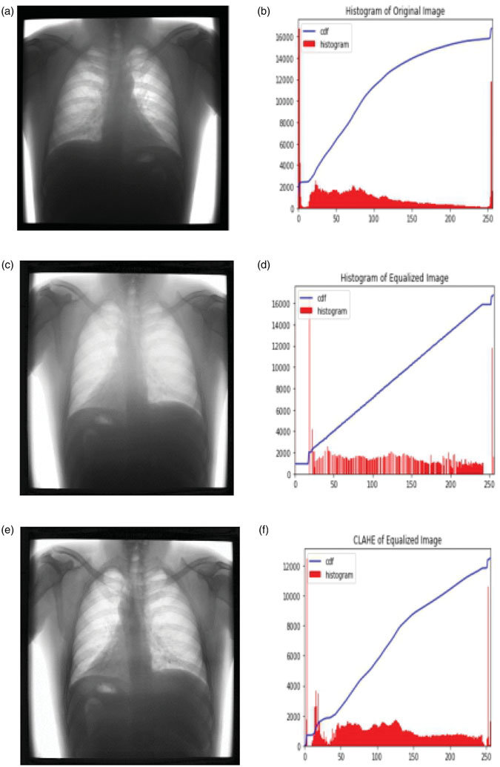
Other variants of histogram equalization

Slide 38
contents
Image representation
Pixel-wise operations
Histogram equalization
Template matching
Morphology operators
Connected components
Color space

Slide 39
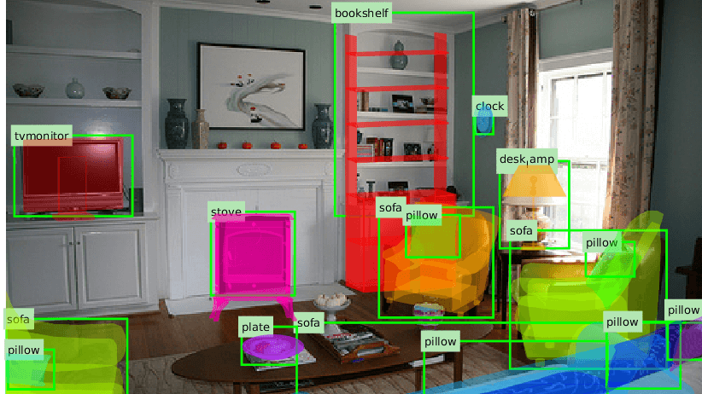
Template matching
Given an image template- find it in another image.
Template matching is a sub-field in object recognition.
We will see it a lot of this topic in this course:
Cross correlation
Feature based – SIFT
Neural networks

Slide 40

Example output
Run pixel-by-pixel for the entire image to look for a match to the template

Slide 41




First- let’s understand what is cross-correlation
image
output
0 | 0 | 0 | 0 | 0 | 0 | 0 | 0 | 0 | 0
0 | 0 | 0 | 0 | 0 | 0 | 0 | 0 | 0 | 0
0 | 0 | 0 | 90 | 90 | 90 | 90 | 90 | 0 | 0
0 | 0 | 0 | 90 | 90 | 90 | 90 | 90 | 0 | 0
0 | 0 | 0 | 90 | 0 | 90 | 90 | 90 | 0 | 0
0 | 0 | 0 | 90 | 90 | 90 | 90 | 90 | 0 | 0
0 | 0 | 0 | 0 | 0 | 0 | 0 | 0 | 0 | 0
0 | 0 | 0 | 0 | 0 | 0 | 0 | 0 | 0 | 0
0 | 0 | 90 | 0 | 0 | 0 | 0 | 0 | 0 | 0
0 | 0 | 0 | 0 | 0 | 0 | 0 | 0 | 0 | 0
kernel
$$\frac{1}{9}$$ | $$\frac{1}{9}$$ | $$\frac{1}{9}$$
$$\frac{1}{9}$$ | $$\frac{1}{9}$$ | $$\frac{1}{9}$$
$$\frac{1}{9}$$ | $$\frac{1}{9}$$ | $$\frac{1}{9}$$
$$g$$
$$f$$
$$h$$

Slide 42
Run the filter
image
output
0 | 0 | 0 | 0 | 0 | 0 | 0 | 0 | 0 | 0
0 | 0 | 0 | 0 | 0 | 0 | 0 | 0 | 0 | 0
0 | 0 | 0 | 90 | 90 | 90 | 90 | 90 | 0 | 0
0 | 0 | 0 | 90 | 90 | 90 | 90 | 90 | 0 | 0
0 | 0 | 0 | 90 | 0 | 90 | 90 | 90 | 0 | 0
0 | 0 | 0 | 90 | 90 | 90 | 90 | 90 | 0 | 0
0 | 0 | 0 | 0 | 0 | 0 | 0 | 0 | 0 | 0
0 | 0 | 0 | 0 | 0 | 0 | 0 | 0 | 0 | 0
0 | 0 | 90 | 0 | 0 | 0 | 0 | 0 | 0 | 0
0 | 0 | 0 | 0 | 0 | 0 | 0 | 0 | 0 | 0
 | 0
kernel
$$\frac{1}{9}$$ | $$\frac{1}{9}$$ | $$\frac{1}{9}$$
$$\frac{1}{9}$$ | $$\frac{1}{9}$$ | $$\frac{1}{9}$$
$$\frac{1}{9}$$ | $$\frac{1}{9}$$ | $$\frac{1}{9}$$
$$g$$
$$f$$
$$h$$

Slide 43
Run the filter
image
output
0 | 0 | 0 | 0 | 0 | 0 | 0 | 0 | 0 | 0
0 | 0 | 0 | 0 | 0 | 0 | 0 | 0 | 0 | 0
0 | 0 | 0 | 90 | 90 | 90 | 90 | 90 | 0 | 0
0 | 0 | 0 | 90 | 90 | 90 | 90 | 90 | 0 | 0
0 | 0 | 0 | 90 | 0 | 90 | 90 | 90 | 0 | 0
0 | 0 | 0 | 90 | 90 | 90 | 90 | 90 | 0 | 0
0 | 0 | 0 | 0 | 0 | 0 | 0 | 0 | 0 | 0
0 | 0 | 0 | 0 | 0 | 0 | 0 | 0 | 0 | 0
0 | 0 | 90 | 0 | 0 | 0 | 0 | 0 | 0 | 0
0 | 0 | 0 | 0 | 0 | 0 | 0 | 0 | 0 | 0
 | 0
kernel
$$\frac{1}{9}$$ | $$\frac{1}{9}$$ | $$\frac{1}{9}$$
$$\frac{1}{9}$$ | $$\frac{1}{9}$$ | $$\frac{1}{9}$$
$$\frac{1}{9}$$ | $$\frac{1}{9}$$ | $$\frac{1}{9}$$
shift
$$g$$
$$f$$
$$h$$

Slide 44
Run the filter
image
output
0 | 0 | 0 | 0 | 0 | 0 | 0 | 0 | 0 | 0
0 | 0 | 0 | 0 | 0 | 0 | 0 | 0 | 0 | 0
0 | 0 | 0 | 90 | 90 | 90 | 90 | 90 | 0 | 0
0 | 0 | 0 | 90 | 90 | 90 | 90 | 90 | 0 | 0
0 | 0 | 0 | 90 | 0 | 90 | 90 | 90 | 0 | 0
0 | 0 | 0 | 90 | 90 | 90 | 90 | 90 | 0 | 0
0 | 0 | 0 | 0 | 0 | 0 | 0 | 0 | 0 | 0
0 | 0 | 0 | 0 | 0 | 0 | 0 | 0 | 0 | 0
0 | 0 | 90 | 0 | 0 | 0 | 0 | 0 | 0 | 0
0 | 0 | 0 | 0 | 0 | 0 | 0 | 0 | 0 | 0
 | 0 | 10
kernel
$$\frac{1}{9}$$ | $$\frac{1}{9}$$ | $$\frac{1}{9}$$
$$\frac{1}{9}$$ | $$\frac{1}{9}$$ | $$\frac{1}{9}$$
$$\frac{1}{9}$$ | $$\frac{1}{9}$$ | $$\frac{1}{9}$$
$$g$$
$$f$$
$$h$$

Slide 45
Run the filter
image
output
0 | 0 | 0 | 0 | 0 | 0 | 0 | 0 | 0 | 0
0 | 0 | 0 | 0 | 0 | 0 | 0 | 0 | 0 | 0
0 | 0 | 0 | 90 | 90 | 90 | 90 | 90 | 0 | 0
0 | 0 | 0 | 90 | 90 | 90 | 90 | 90 | 0 | 0
0 | 0 | 0 | 90 | 0 | 90 | 90 | 90 | 0 | 0
0 | 0 | 0 | 90 | 90 | 90 | 90 | 90 | 0 | 0
0 | 0 | 0 | 0 | 0 | 0 | 0 | 0 | 0 | 0
0 | 0 | 0 | 0 | 0 | 0 | 0 | 0 | 0 | 0
0 | 0 | 90 | 0 | 0 | 0 | 0 | 0 | 0 | 0
0 | 0 | 0 | 0 | 0 | 0 | 0 | 0 | 0 | 0
 | 0 | 10 | 20
kernel
$$\frac{1}{9}$$ | $$\frac{1}{9}$$ | $$\frac{1}{9}$$
$$\frac{1}{9}$$ | $$\frac{1}{9}$$ | $$\frac{1}{9}$$
$$\frac{1}{9}$$ | $$\frac{1}{9}$$ | $$\frac{1}{9}$$
$$g$$
$$f$$
$$h$$

Slide 46
Run the filter
image
output
0 | 0 | 0 | 0 | 0 | 0 | 0 | 0 | 0 | 0
0 | 0 | 0 | 0 | 0 | 0 | 0 | 0 | 0 | 0
0 | 0 | 0 | 90 | 90 | 90 | 90 | 90 | 0 | 0
0 | 0 | 0 | 90 | 90 | 90 | 90 | 90 | 0 | 0
0 | 0 | 0 | 90 | 0 | 90 | 90 | 90 | 0 | 0
0 | 0 | 0 | 90 | 90 | 90 | 90 | 90 | 0 | 0
0 | 0 | 0 | 0 | 0 | 0 | 0 | 0 | 0 | 0
0 | 0 | 0 | 0 | 0 | 0 | 0 | 0 | 0 | 0
0 | 0 | 90 | 0 | 0 | 0 | 0 | 0 | 0 | 0
0 | 0 | 0 | 0 | 0 | 0 | 0 | 0 | 0 | 0
 | 0 | 10 | 20 | 30
kernel
$$\frac{1}{9}$$ | $$\frac{1}{9}$$ | $$\frac{1}{9}$$
$$\frac{1}{9}$$ | $$\frac{1}{9}$$ | $$\frac{1}{9}$$
$$\frac{1}{9}$$ | $$\frac{1}{9}$$ | $$\frac{1}{9}$$
$$g$$
$$f$$
$$h$$

Slide 47
Run the filter
image
output
0 | 0 | 0 | 0 | 0 | 0 | 0 | 0 | 0 | 0
0 | 0 | 0 | 0 | 0 | 0 | 0 | 0 | 0 | 0
0 | 0 | 0 | 90 | 90 | 90 | 90 | 90 | 0 | 0
0 | 0 | 0 | 90 | 90 | 90 | 90 | 90 | 0 | 0
0 | 0 | 0 | 90 | 0 | 90 | 90 | 90 | 0 | 0
0 | 0 | 0 | 90 | 90 | 90 | 90 | 90 | 0 | 0
0 | 0 | 0 | 0 | 0 | 0 | 0 | 0 | 0 | 0
0 | 0 | 0 | 0 | 0 | 0 | 0 | 0 | 0 | 0
0 | 0 | 90 | 0 | 0 | 0 | 0 | 0 | 0 | 0
0 | 0 | 0 | 0 | 0 | 0 | 0 | 0 | 0 | 0
 | 0 | 10 | 20 | 30 | 30
kernel
$$\frac{1}{9}$$ | $$\frac{1}{9}$$ | $$\frac{1}{9}$$
$$\frac{1}{9}$$ | $$\frac{1}{9}$$ | $$\frac{1}{9}$$
$$\frac{1}{9}$$ | $$\frac{1}{9}$$ | $$\frac{1}{9}$$
$$g$$
$$f$$
$$h$$

Slide 48
Run the filter
image
output
0 | 0 | 0 | 0 | 0 | 0 | 0 | 0 | 0 | 0
0 | 0 | 0 | 0 | 0 | 0 | 0 | 0 | 0 | 0
0 | 0 | 0 | 90 | 90 | 90 | 90 | 90 | 0 | 0
0 | 0 | 0 | 90 | 90 | 90 | 90 | 90 | 0 | 0
0 | 0 | 0 | 90 | 0 | 90 | 90 | 90 | 0 | 0
0 | 0 | 0 | 90 | 90 | 90 | 90 | 90 | 0 | 0
0 | 0 | 0 | 0 | 0 | 0 | 0 | 0 | 0 | 0
0 | 0 | 0 | 0 | 0 | 0 | 0 | 0 | 0 | 0
0 | 0 | 90 | 0 | 0 | 0 | 0 | 0 | 0 | 0
0 | 0 | 0 | 0 | 0 | 0 | 0 | 0 | 0 | 0
 | 0 | 10 | 20 | 30 | 30 | 30
kernel
$$\frac{1}{9}$$ | $$\frac{1}{9}$$ | $$\frac{1}{9}$$
$$\frac{1}{9}$$ | $$\frac{1}{9}$$ | $$\frac{1}{9}$$
$$\frac{1}{9}$$ | $$\frac{1}{9}$$ | $$\frac{1}{9}$$
$$g$$
$$f$$
$$h$$

Slide 49


… and the result is
image
output
0 | 0 | 0 | 0 | 0 | 0 | 0 | 0 | 0 | 0
0 | 0 | 0 | 0 | 0 | 0 | 0 | 0 | 0 | 0
0 | 0 | 0 | 90 | 90 | 90 | 90 | 90 | 0 | 0
0 | 0 | 0 | 90 | 90 | 90 | 90 | 90 | 0 | 0
0 | 0 | 0 | 90 | 0 | 90 | 90 | 90 | 0 | 0
0 | 0 | 0 | 90 | 90 | 90 | 90 | 90 | 0 | 0
0 | 0 | 0 | 0 | 0 | 0 | 0 | 0 | 0 | 0
0 | 0 | 0 | 0 | 0 | 0 | 0 | 0 | 0 | 0
0 | 0 | 90 | 0 | 0 | 0 | 0 | 0 | 0 | 0
0 | 0 | 0 | 0 | 0 | 0 | 0 | 0 | 0 | 0
 | 0 | 10 | 20 | 30 | 30 | 30 | 20 | 10
 | 0 | 20 | 40 | 60 | 60 | 60 | 40 | 20
 | 0 | 30 | 50 | 80 | 80 | 90 | 60 | 30
 | 0 | 30 | 50 | 80 | 80 | 90 | 60 | 30
 | 0 | 20 | 30 | 50 | 50 | 60 | 40 | 20
 | 0 | 10 | 20 | 30 | 30 | 30 | 20 | 10
 | 10 | 10 | 10 | 10 | 0 | 0 | 0 | 0
 | 10 | 10 | 10 | 10 | 0 | 0 | 0 | 0
kernel
$$\frac{1}{9}$$ | $$\frac{1}{9}$$ | $$\frac{1}{9}$$
$$\frac{1}{9}$$ | $$\frac{1}{9}$$ | $$\frac{1}{9}$$
$$\frac{1}{9}$$ | $$\frac{1}{9}$$ | $$\frac{1}{9}$$
$$g$$
$$f$$
$$h$$
Cross correlation can also be more simply denoted as $h=g⋆f$
The full mathematical notation is this:
Notes:
h[m,n]=\sum_{k=-1}^{1}\sum_{l=-1}^{1}g[k,l]f[m+k,n+l]

Slide 50

CC – cross correlation
Can cross-correlation be good for template matching? Let’s take our template that we want to find as our kernel
output
What will the output look like?
image

Slide 51
CC – cross correlation
What will the output look like?
output
image

Slide 52


CC – cross correlation
The result will be a 2D heatmap from 0 to a very large number
($\sim N∗N∗{255}^{2}$)
output
image

Slide 53

CC – cross correlation
output
image
Is this good for template matching?

Slide 54
CC – cross correlation
output
image
Increases for higher local intensities.

Slide 55





CC
255 | 255 | 255
255 | 0 | 255
255 | 255 | 255
255 | 255 | 255
255 | 255 | 255
255 | 255 | 255
$$g$$
$$f$$
$${255}^{2}$$ | $${255}^{2}$$ | $${255}^{2}$$
$${255}^{2}$$ | $$0$$ | $${255}^{2}$$
$${255}^{2}$$ | $${255}^{2}$$ | $${255}^{2}$$
$${8∗255}^{2}$$
😢
$$h$$
1. Scalar multiplication
2. Summation

Slide 56

CC
128 | 128 | 128
128 | 0 | 128
128 | 128 | 128
255 | 255 | 255
255 | 255 | 255
255 | 255 | 255
$$g$$
$$f$$
128∗255 | 128∗255 | 128∗255
128∗255 | $$0$$ | 128∗255
128∗255 | 128∗255 | 128∗255
261120
😢
$$h$$
1. Scalar multiplication
2. Summation

Slide 57

Zero mean cross correlation
template mean
What will the output look like?

Slide 58


Zero mean cross correlation
output
template mean
True detection
thresholding
False detections
Zero mean CC is good enough for most problems but can also cause false detections in high contrast areas.

Slide 59


Zero mean CC
14 | 14 | 14
14 | -113 | 14
14 | 14 | 14
255 | 255 | 255
255 | 255 | 255
255 | 255 | 255
$$g−\overline{g}$$
$$f$$
$$3570$$ | $$3570$$ | $$3570$$
$$3570$$ | $$−28815$$ | $$3570$$
$$3570$$ | $$3570$$ | $$3570$$
-255
😮
$$h$$
1. Scalar multiplication
2. Summation

Slide 60

Zero mean CC
14 | 14 | 14
14 | -113 | 14
14 | 14 | 14
128 | 128 | 128
128 | 0 | 128
128 | 128 | 128
$$g−\overline{g}$$
$$f$$
$$1792$$ | $$1792$$ | $$1792$$
$$1792$$ | $$0$$ | $$1792$$
$$1792$$ | $$1792$$ | $$1792$$
14336
😍
$$h$$
1. Scalar multiplication
2. Summation

Slide 61

Zero mean CC
14 | 14 | 14
14 | -113 | 14
14 | 14 | 14
0 | 0 | 255
0 | 0 | 255
255 | 255 | 255
$$g−\overline{g}$$
$$f$$
$$0$$ | $$0$$ | $$3570$$
$$0$$ | $$0$$ | $$3570$$
$$3570$$ | $$3570$$ | $$3570$$
17850
😢
$$h$$
1. Scalar multiplication
2. Summation

Slide 62

ZNCC – zero mean normalized cross correlation
What will the output look like?
The below square root is the product of both template and patch STD. For clarity let’s treat it as normalization of the image-patch and template [-1,1]

Slide 63


ZNCC – zero mean normalized cross correlation
output
True detections
thresholding

Slide 64


ZNCC – zero mean normalized cross correlation
output
True detections
thresholding
robust to change in intensities

Slide 65


Zero mean normalized CC
1 | 1 | 1
1 | -1 | 1
1 | 1 | 1
0 | 0 | 0
0 | 0 | 0
0 | 0 | 0
$norm(g−\overline{g}$)
$norm(f−\overline{f}$)
0
😍
$$h$$
Summation

Slide 66
Zero mean normalized CC
1 | 1 | 1
1 | -1 | 1
1 | 1 | 1
1 | 1 | 1
1 | -1 | 1
1 | 1 | 1
$norm(g−\overline{g}$)
$norm(f−\overline{f}$)
9
😍
$$h$$
Summation

Slide 67
Zero mean normalized CC
1 | 1 | 1
1 | -1 | 1
1 | 1 | 1
-1 | -1 | 1
-1 | -1 | 1
1 | 1 | 1
$norm(g−\overline{g}$)
$norm(f−\overline{f}$)
6
😍
$$h$$
Summation

Slide 68
contents
Image representation
Pixel-wise operations
Histogram equalization
Template matching
Morphology operators
Connected components
Color space

Slide 69




Morphology
Examples:
Image cleaning
Style
Coin counting
(using connected components)
Notes:
\theta_{TH}(x,t) = \left\{\begin{matrix}
1 & if & x\geq t,\\
0 & else
\end{matrix}
g = f*s
s = \begin{bmatrix}
0 & 0 & 1 & 0 & 0\\
0 & 1 & 1 & 1 & 0\\
1 & 1 & 1 & 1 & 1\\
0 & 1 & 1 & 1 & 0\\
0 & 0 & 1 & 0 & 0
\end{bmatrix}
k = \theta_{TH}(f*s,t)

Slide 70

The 4 basic operators

Slide 71


Morphology: geometric interpretation
Each kernel ($g$) has an anchor point (usually in the kernel center).
Dilation: the final shape is all points where the anchor point can be placed in which the kernel touches a part of the original shape.
Erosion: the final shape is all points where the anchor point can be placed in which all kernel points touch the original shape.
Notes:
\theta_{TH}(x,t) = \left\{\begin{matrix}
1 & if & x\geq t,\\
0 & else
\end{matrix}
g = f*s
s = \begin{bmatrix}
0 & 0 & 1 & 0 & 0\\
0 & 1 & 1 & 1 & 0\\
1 & 1 & 1 & 1 & 1\\
0 & 1 & 1 & 1 & 0\\
0 & 0 & 1 & 0 & 0
\end{bmatrix}
k = \theta_{TH}(f*s,t)

Slide 72


1. Cross-correlation with the kernel
0 | 0 | 0 | 0 | 0 | 0 | 0 | 0
0 | 0 | 0 | 0 | 0 | 0 | 1 | 0
0 | 1 | 1 | 1 | 1 | 0 | 0 | 0
0 | 1 | 1 | 1 | 1 | 1 | 1 | 0
0 | 1 | 1 | 1 | 1 | 0 | 0 | 0
0 | 1 | 1 | 1 | 1 | 0 | 0 | 0
0 | 1 | 1 | 0 | 0 | 0 | 0 | 0
0 | 1 | 1 | 0 | 0 | 0 | 0 | 0
 | 2 | 3 | 3 | 2 | 2 | 1
 | 4 | 6 | 6 | 5 | 5 | 3
 | 6 | 9 | 9 | 7 | 5 | 2
 | 6 | 9 | 9 | 7 | 5 | 2
 | 6 | 8 | 7 | 4 | 2 | 0
 | 6 | 7 | 5 | 2 | 1 | 0
1 | 1 | 1
1 | 1 | 1
1 | 1 | 1
=
$$g$$
$$f$$

Slide 73

2. Threshold the result
For dilation- threshold with 1
 | 2 | 3 | 3 | 2 | 2 | 1
 | 4 | 6 | 6 | 5 | 5 | 3
 | 6 | 9 | 9 | 7 | 5 | 2
 | 6 | 9 | 9 | 7 | 5 | 2
 | 6 | 8 | 7 | 4 | 2 | 0
 | 6 | 7 | 5 | 2 | 1 | 0
 | 1 | 1 | 1 | 1 | 1 | 1
 | 1 | 1 | 1 | 1 | 1 | 1
 | 1 | 1 | 1 | 1 | 1 | 1
 | 1 | 1 | 1 | 1 | 1 | 1
 | 1 | 1 | 1 | 1 | 1 | 0
 | 1 | 1 | 1 | 1 | 1 | 0
$$≥1=$$

Slide 74


2. Threshold the result
For erosion- threshold with the sum of the kernel
 | 2 | 3 | 3 | 2 | 2 | 1
 | 4 | 6 | 6 | 5 | 5 | 3
 | 6 | 9 | 9 | 7 | 5 | 2
 | 6 | 9 | 9 | 7 | 5 | 2
 | 6 | 8 | 7 | 4 | 2 | 0
 | 6 | 7 | 5 | 2 | 1 | 0
 | 0 | 0 | 0 | 0 | 0 | 0
 | 0 | 0 | 0 | 0 | 0 | 0
 | 0 | 1 | 1 | 0 | 0 | 0
 | 0 | 1 | 1 | 0 | 0 | 0
 | 0 | 0 | 0 | 0 | 0 | 0
 | 0 | 0 | 0 | 0 | 0 | 0
$$≥sum(g)=$$
$sum\left(g\right)=9$in this example

Slide 75



Morphology: algorithm
Each morphology operator is constructed as such:
Select a structure element (binary kernel)
Cross-correlate with input binary image $h=f⋆g$
Threshold the output
Overall morphologic operation should look like so:
$$k=θ_{TH}(f⋆g,t)$$
Notes:
\theta_{TH}(x,t) = \left\{\begin{matrix}
1 & if & x\geq t,\\
0 & else
\end{matrix}
g = f*s
s = \begin{bmatrix}
0 & 0 & 1 & 0 & 0\\
0 & 1 & 1 & 1 & 0\\
1 & 1 & 1 & 1 & 1\\
0 & 1 & 1 & 1 & 0\\
0 & 0 & 1 & 0 & 0
\end{bmatrix}
k = \theta_{TH}(f*s,t)

Slide 76


Dilation- examples
$k=θ_{TH}(f⋆g,t=1)$
Notes:
\theta_{TH}(x,t) = \left\{\begin{matrix}
1 & if & x\geq t,\\
0 & else
\end{matrix}
g = f*s
s = \begin{bmatrix}
0 & 0 & 1 & 0 & 0\\
0 & 1 & 1 & 1 & 0\\
1 & 1 & 1 & 1 & 1\\
0 & 1 & 1 & 1 & 0\\
0 & 0 & 1 & 0 & 0
\end{bmatrix}

Slide 77


Erosion- examples
$k=θ_{TH}(f⋆g,t=sum(g))$
Notes:
\theta_{TH}(x,t) = \left\{\begin{matrix}
1 & if & x\geq t,\\
0 & else
\end{matrix}
g = f*s
s = \begin{bmatrix}
0 & 0 & 1 & 0 & 0\\
0 & 1 & 1 & 1 & 0\\
1 & 1 & 1 & 1 & 1\\
0 & 1 & 1 & 1 & 0\\
0 & 0 & 1 & 0 & 0
\end{bmatrix}

Slide 78


Opening
Erosion followed by dilation.
The effect is of removing noise or sharp edges.

Slide 79


Closing
Dilation followed by erosion.
The effect is of closing of narrow gaps and holes.

Slide 80


Affect of different kernels
We will see non-symmetrical kernels in the HW

Slide 81
contents
Image representation
Pixel-wise operations
Histogram equalization
Template matching
Morphology operators
Connected components
Color space

Slide 82

Connected components
Defined as regions of adjacent pixels that have the same value.
Commonly used with binary images to find stand alone objects.
e.g.: letters in a document.

Slide 83
contents
Image representation
Pixel-wise operations
Histogram equalization
Template matching
Morphology operators
Connected components
Color space

Slide 84

HSV
https://cs.brown.edu/courses/csci1430/lectures/2020Spring_08_CamerasLightAndColor.pdf

Slide 85
HSV
Hue: The "attribute of a visual sensation according to which an area appears to be similar to one of the perceived colors: red, yellow, green, and blue, or to a combination of two of them"
Saturation: The "colorfulness of a stimulus relative to its own brightness"
Value: The "brightness relative to the brightness of a similarly illuminated white“. Can also be called brightness or intensity.
[Wikipedia]

Slide 86


Slide 87


Slide 88

HSV
In e, f, g: single channel image representation.
Conclusion: people are much more responsive to intensity then chroma.

Slide 89

More color spaces: LAB
L: lightness from black (0) to white (100).
A: from green (−) to red (+).
B: from blue (−) to yellow (+).

Slide 90


More color spaces: YUV
Y: brightness/ intensity.
U: blue projection.
V: red projection.
[Similar to YCbCr]
Y=0.5

